Slide 1
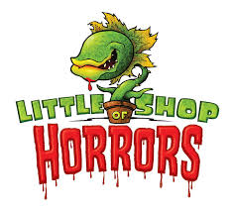
Little Shop of Horrors
By Rhian McSporran

Slide 2
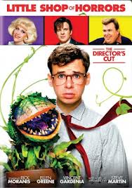
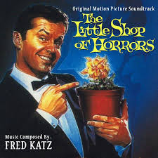
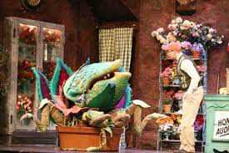
history
The first Little shop of horrors was a 1960 comedy film directed by Roger Corman. The film is thought to based on a 1932 story called “green thoughts.” It was then turned into a musical by composer Alan Menken. Then finally turned back into a film which was a mix of the both musical and comedy directed by Frank Oz.

Slide 3
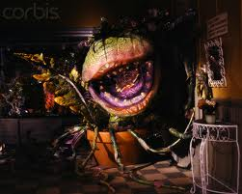
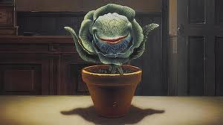
Outline
The outline of the story is about an orphan nerdy boy called Seymour, who is given a job by Mr Mushnik the owner of a florist which doesn’t get business at all. Seymour spends his time doing tasks that are a waste of his time. Then after an eclipse of the sun, Seymour discovers and strange plant at a Japanese flower shop he buys it and names it Audrey 2. Whilst caring the plant he discovers the plants strange appetite. Which is human blood and flesh. The plant then grows bigger by the day and then wants to take over the world which was its plan the whole time.

Slide 4
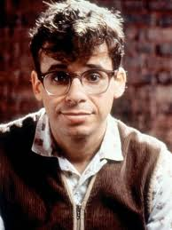
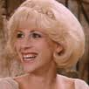
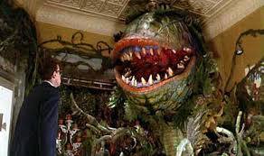
Main Characters
Seymour Krelborn: Seymour is the unlikely hero of the story; He is the one who found the plant Audrey II.
Audrey Fulquard: Audrey works along with Seymour and is the secret love of his life.
Audrey II is a plant crossed between a Venus flytrap and an avocado with teeth. Audrey II is Seymour’s favourite and soon famous plant.

Slide 5
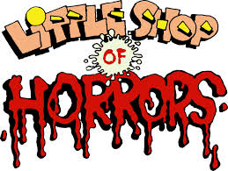
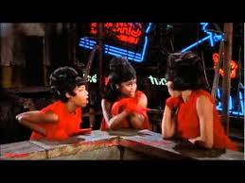
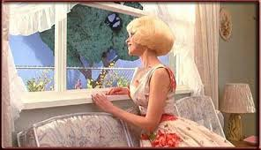
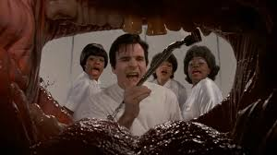
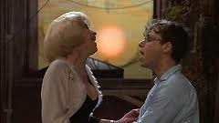
5 Best Songs
Little shop of Horrors
Skid Row
Somewhere that’s Green
Dentist
Suddenly Seymour

Slide 6
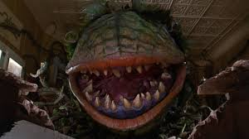
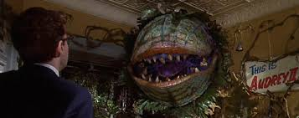
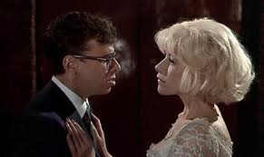
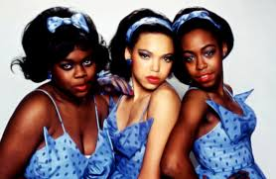
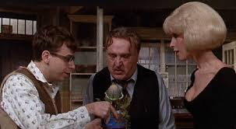
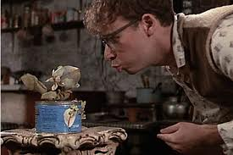
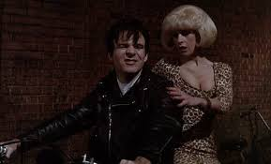
Pictures

Slide 7
The end!!!

