Slide 1
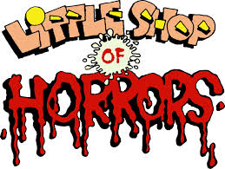

Slide 2
History

Slide 3
Plot
Seymour, an orphan and a nerd, is taken in and given a job by Mr Mushnik, the owner of a rundown florists in the seedy part of town. Seymour spends his time doing menial tasks and dreaming of the shop assistant, Audrey. One day, just after an eclipse of the Sun, Seymour discovers a strange plant. He buys it and names it Audrey II. While caring for Audrey II, Seymour discovers the plant's rather unique appetite. The plant grows and grows, as does Seymour's infatuation for Audrey.

Slide 4
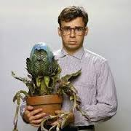
Seymour
actor from 1986 film
Employed in the run-down East Side Flower Shop in skid row. Seymour is the insecure, naïve, put upon florist’s clerk – our hero. He’s sweet and well-meaning, somewhat shy, awkward; lacking in social skills.

Slide 5
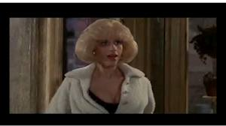
Audrey
actress from 1986 film
The other employee of the East Side Flower Shop, she is honest and attractive, but has very low self-esteem and therefore dresses like trash, attracting all the wrong guys. Not well-educated, and a bit air-headed.

Slide 6
Mr.Mushnik
actor from 1986 film
Owner of the flower shop; the boss. He is a failure of a florist.

Slide 7
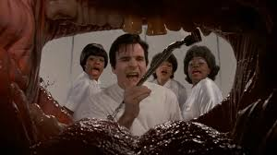
Orin
actor from 1986 film
rough and insensitive; Audrey’s abusive boyfriend. He’s an aggressive dentist, all got up like a greaser, but thinks like an insurance salesman and is in love with the sound of his own voice

Slide 8
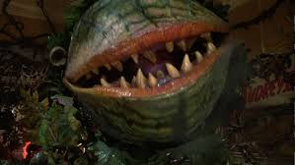
Audrey II
A wise-cracking anthropomorphic cross between a Venus flytrap and an avocado with teeth, Audrey II is Seymour’s favourite and soon-famous plant, but once the plant has the taste of human blood there is no stopping it.

Slide 9
Songs
In order
Little Shop of Horrors
Skid row
Da doo
Grow for me

Slide 10
Ya never Know
Mushnik and son
Dentist
Somewhere that’s green
Feed me

Slide 11
Songs
Now (It's Just the Gas)
Closed For Renovation
Suddenly Seymour
Suppertime
The Meek Shall Inherit
Finale (Don't Feed the Plants)

Slide 12
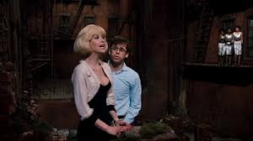
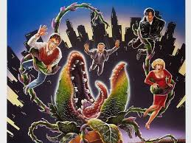
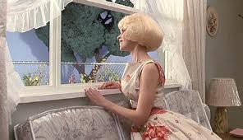
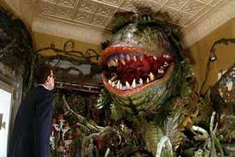
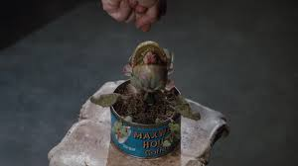
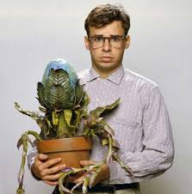
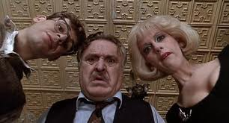
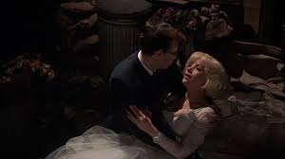
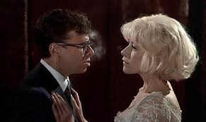
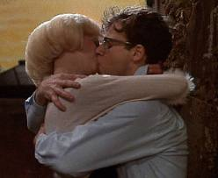
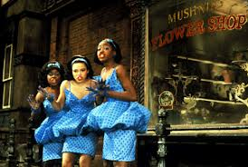
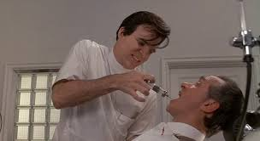
Pictures form 1986 film

